Slide 1
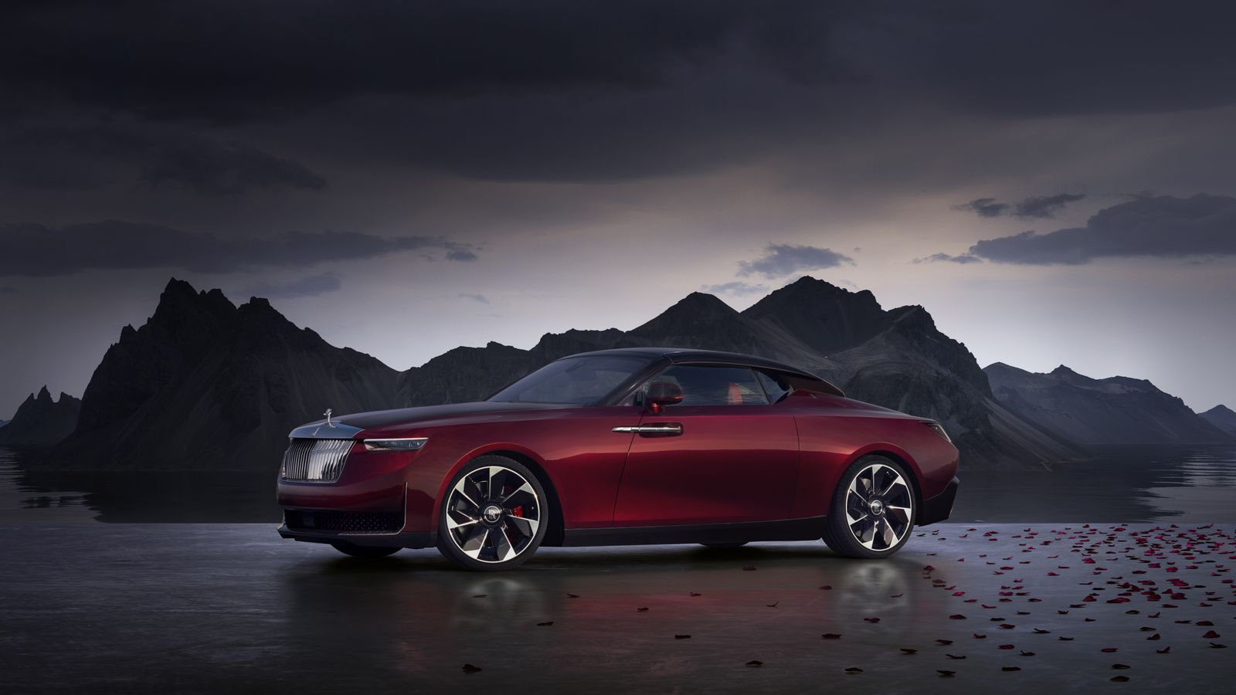
WheelDeal

Slide 2
Introduction to WheelDeal
WheelDeal is your gateway to experiencing the thrill of driving the world’s most luxurious and powerful supercars.
Our platform offers a seamless and personalized rental experience, catering to car enthusiasts and luxury seekers.
With a diverse fleet of high-end vehicles, we ensure that you drive only the best.
Whether it’s for a special occasion or just to indulge, WheelDeal delivers unmatched elegance and performance.

Slide 3
Product Introduction
WheelDeal is an online platform that provides short-term rentals of luxury and supercars. Our service is designed for those who wish to experience the power, prestige, and luxury of top-tier vehicles without the long-term commitment of ownership.
High-net-worth individuals, car enthusiasts, tourists, and anyone looking to add a touch of luxury to their travel or special events.

Slide 4
Market Competitors
Turo: A peer-to-peer car-sharing platform offering a wide range of vehicles, including luxury and supercars.
SIXT Luxury Cars: A well-established car rental service specializing in high-end vehicles.
Enterprise Exotic Car Collection: A premium service offered by Enterprise, focusing on luxury and exotic cars.
Hertz Dream Cars: A specialized service by Hertz that provides access to luxury and performance vehicles.

Slide 5
Competitive Edge of WheelDeal
Curated collection of the latest models.
Exclusive membership benefits.
Superior customer service with a personalized touch.

Slide 6
Product Features
Wide Selection: Choose from an extensive range of luxury and supercars, including brands like Ferrari, Lamborghini, Bentley, and more.
Flexible Rental Periods: Rent vehicles for as little as a few hours to several weeks, depending on your needs.
Premium Experience: Enjoy features like door-to-door delivery, 24/7 customer support, and optional chauffeur services.
Easy Booking: User-friendly website and mobile app for seamless browsing, booking, and managing rentals.

Slide 7
Upcoming Features
Subscription Model: Introducing a membership plan with exclusive discounts, priority booking, and access to limited edition vehicles.
User Leasing Option: Allow users to lease their vehicles through WheelDeal, giving them the opportunity to earn income by renting out their luxury or supercars when not in use.
Admin Dashboard: Provide vehicle owners with a dedicated dashboard where they can manage their listings, track earnings, view booking history, and set availability.

Slide 8
Detailing and Modification Services
Detailing Services: WheelDeal offers comprehensive detailing services to ensure your car always looks its best. From exterior polishing to interior deep cleaning, our professional team uses premium products and techniques to maintain your vehicle's showroom shine.
High-Quality Products: We use only top-tier products for detailing and modifications to guarantee the best results and long-lasting effects.
Expert Technicians: Our team consists of experienced professionals who are passionate about cars and dedicated to delivering superior service.
Personalized Experience: We work closely with you to understand your vision and provide tailored services that meet your specific needs and preferences.
Convenient Service: Enjoy the convenience of on-site detailing and modification services at your location or visit our state-of-the-art facility.

Slide 9
Future Scope
Expansion to New Markets: Launching WheelDeal in major global cities to cater to a growing demand for luxury car rentals.
Partnerships with High-End Brands: Collaborating with luxury hotels, resorts, and airlines to offer exclusive rental packages.
Sustainability Initiatives: Introducing electric luxury vehicles to the fleet, supporting a green future.
Enhanced Customer Experience: Leveraging VR and AR technologies for virtual tours of cars before booking and immersive driving experiences.

Slide 10
Features
Automation of the entire system improves the efficiency
It provides a friendly graphical user interface which proves to be better when compared to the existing system.
It gives appropriate access to the authorized users depending on their permissions.
It effectively overcomes the delay in communications.
Updating of information becomes so easier.
System security, data security and reliability are the striking features.
The System has adequate scope for modification in future if it is necessary.

Slide 11
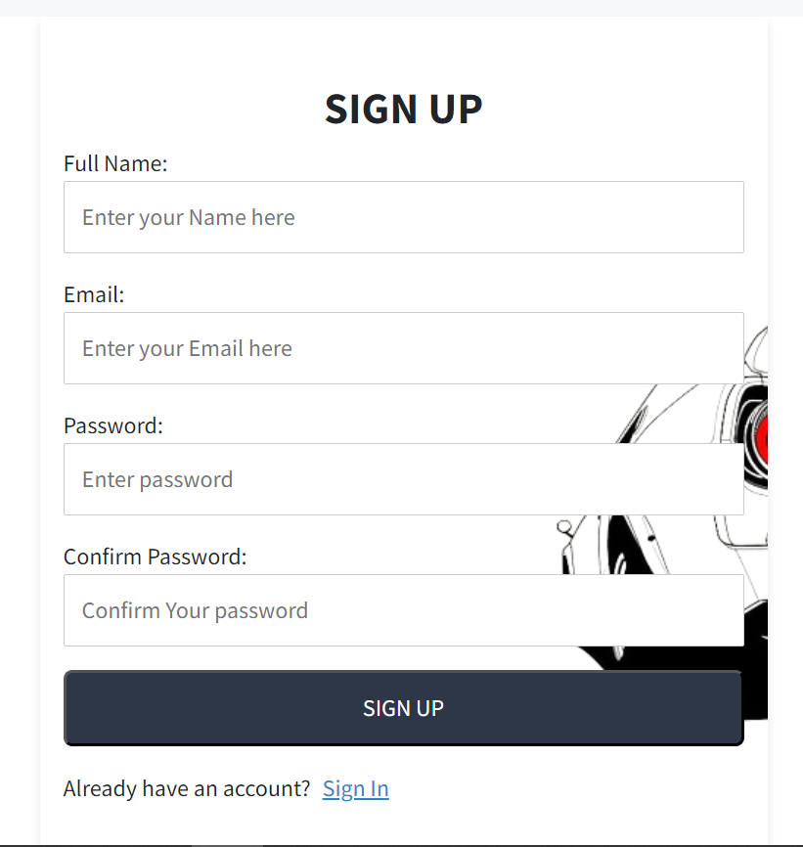
Login /SignUp

Slide 12
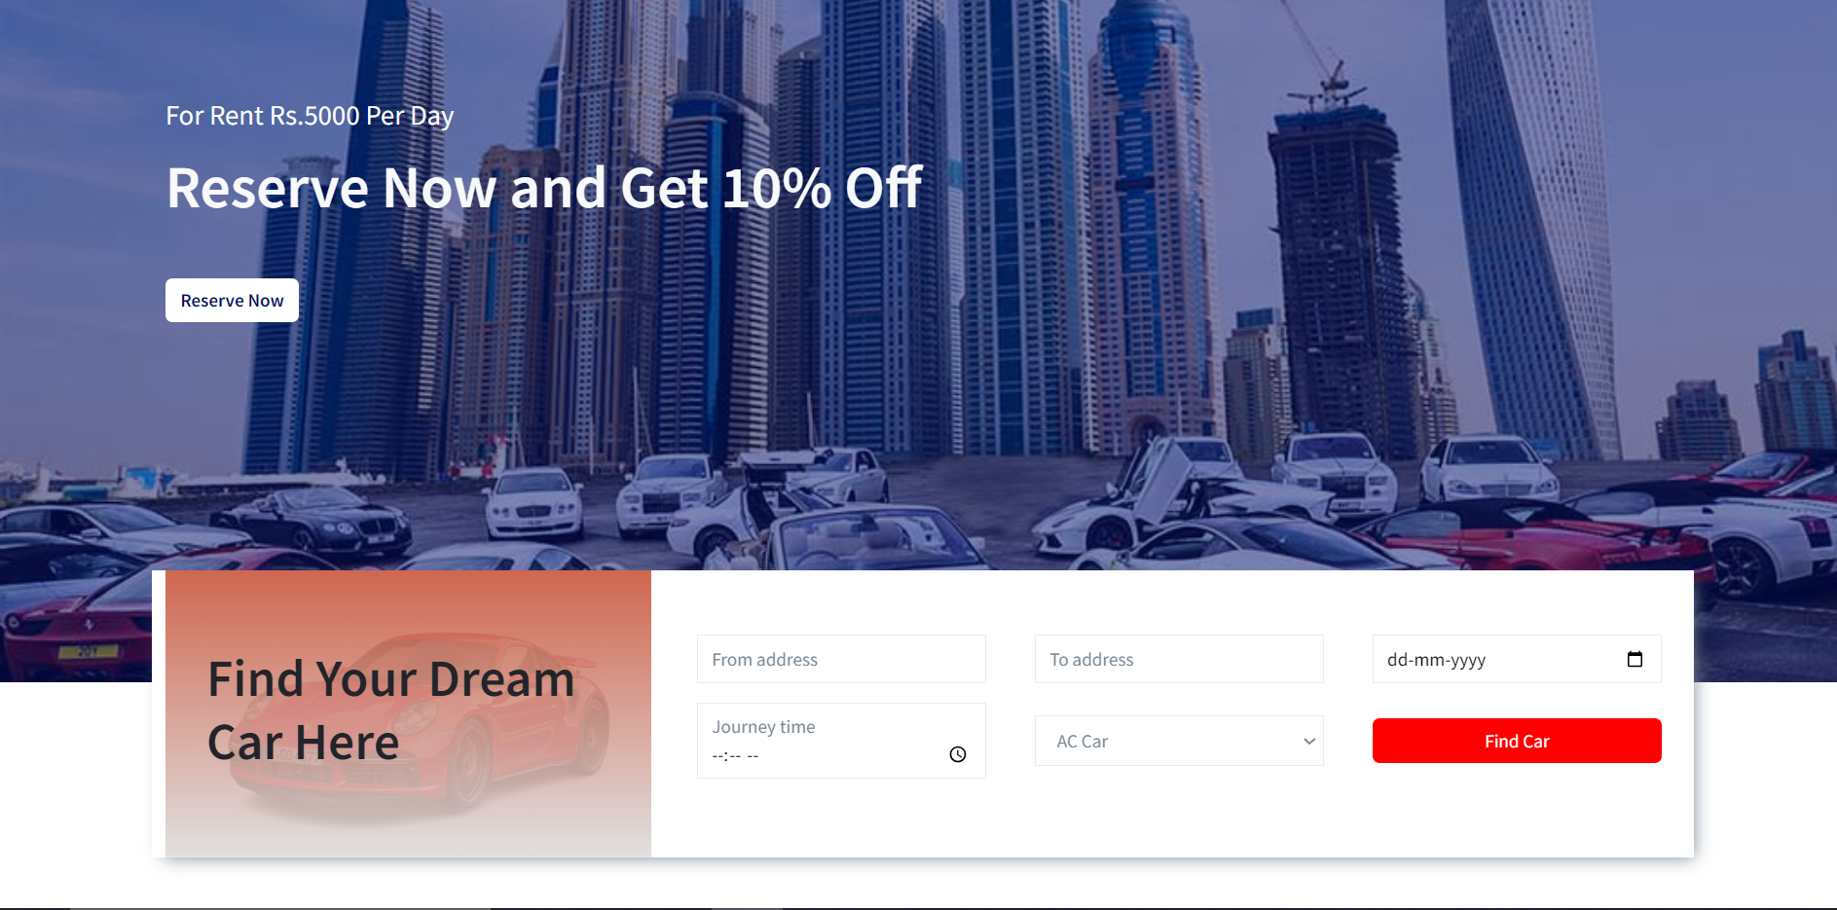
Website Overview(Home Page)

Slide 13
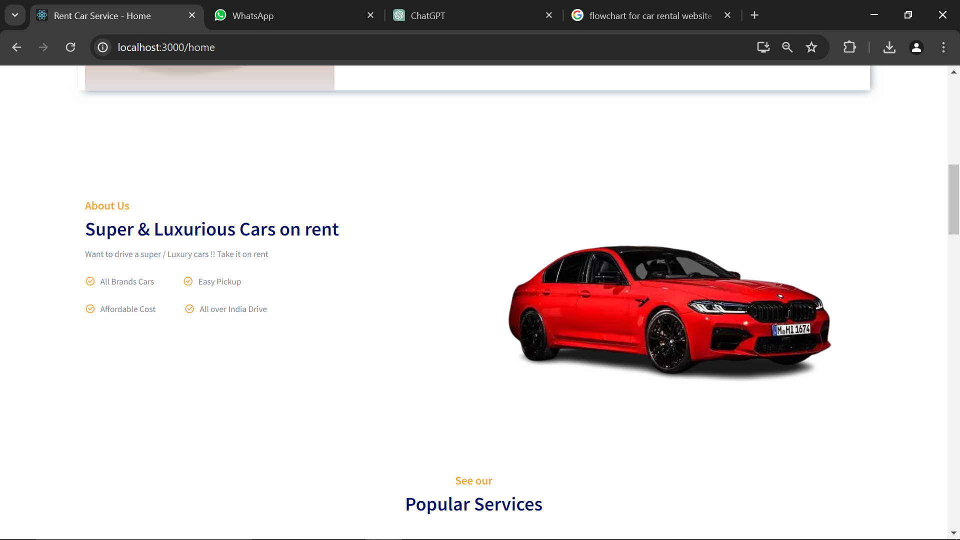
Website Overview(Home Page)

Slide 14
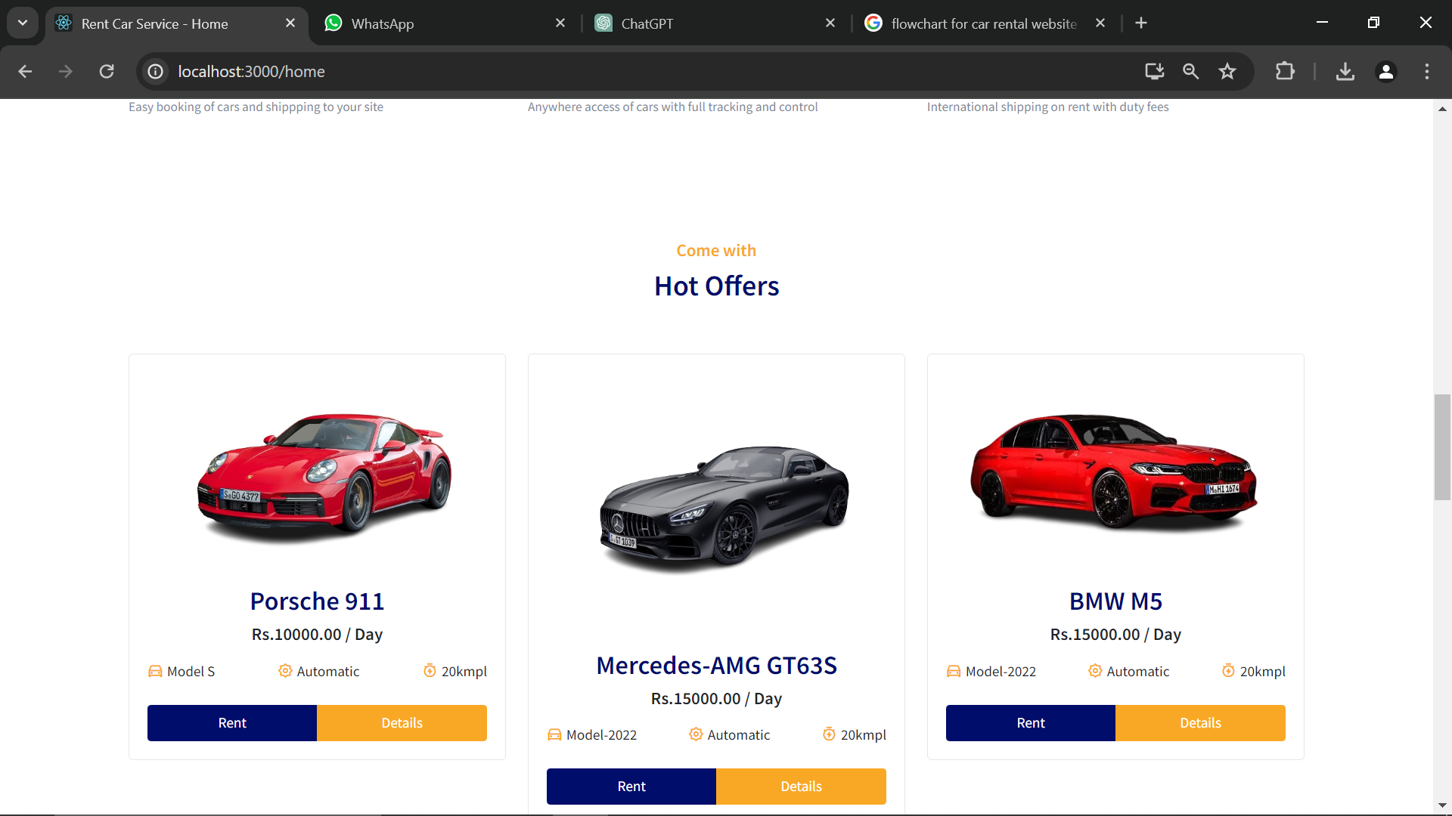
Website Overview(Car Section)

Slide 15
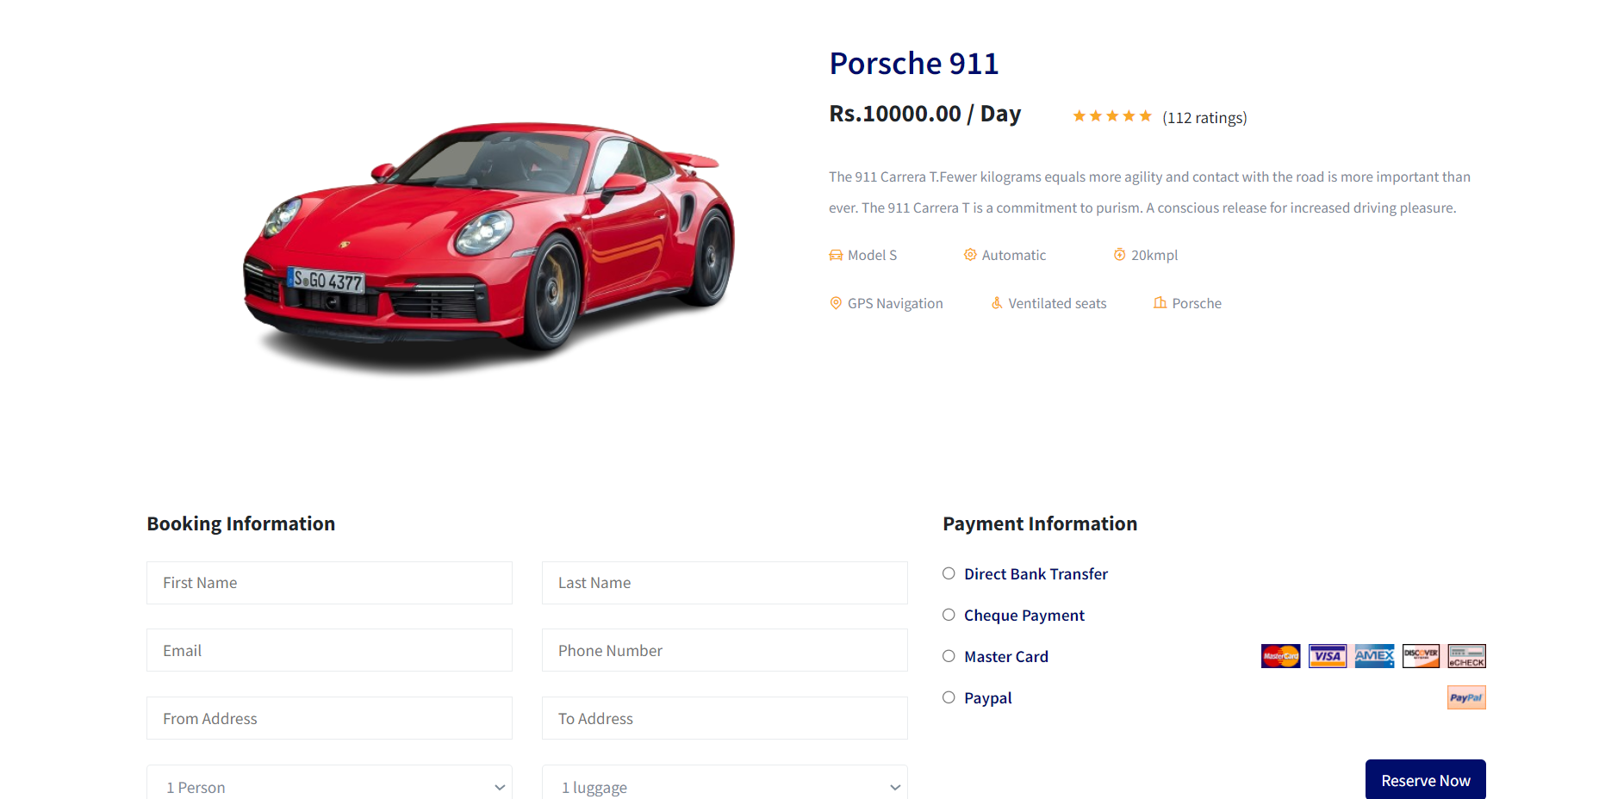
Website Overview(Product Page)

Slide 16
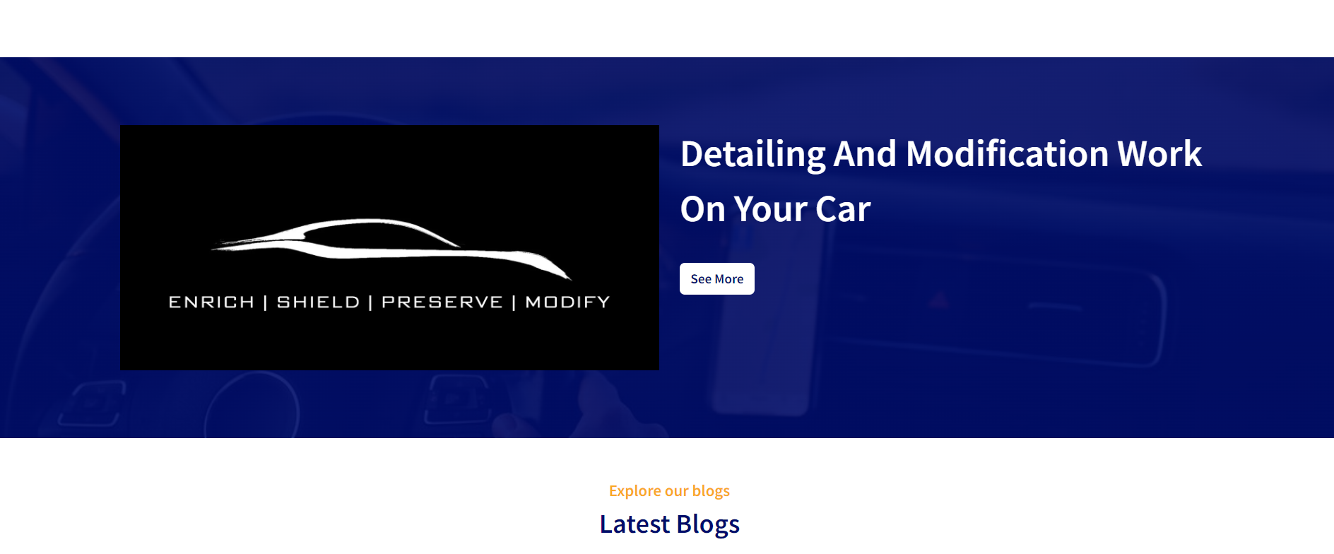
Website Overview(Detailing)

Slide 17
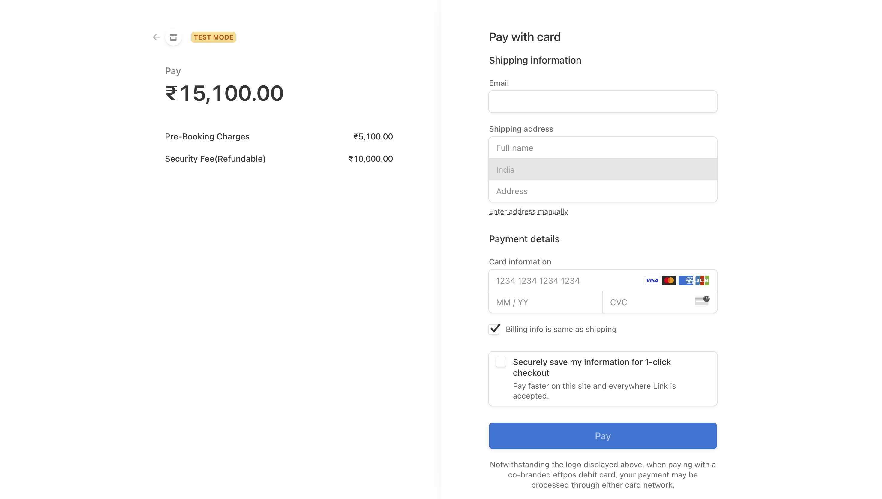
Payment Gateway

Slide 18
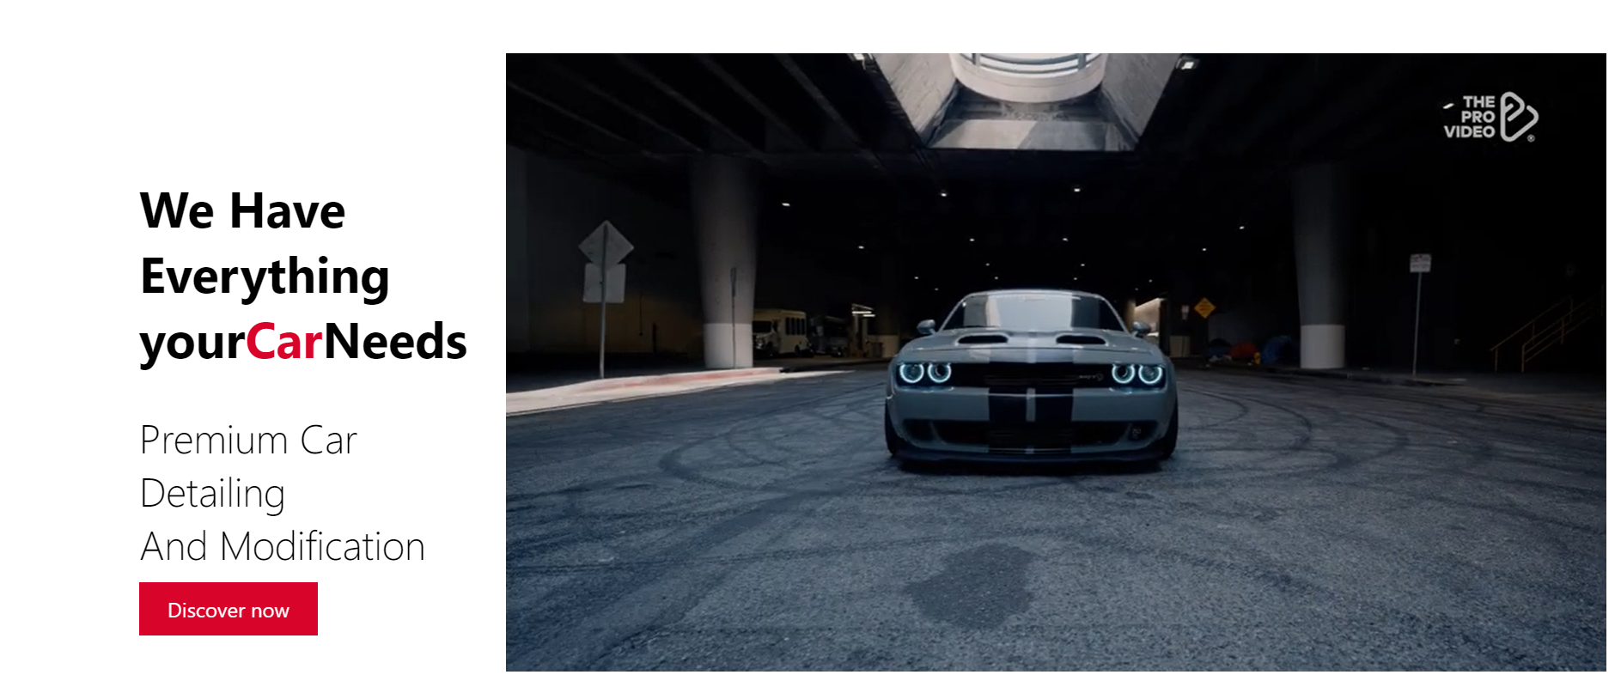
Detailing And Modification Overview

Slide 19
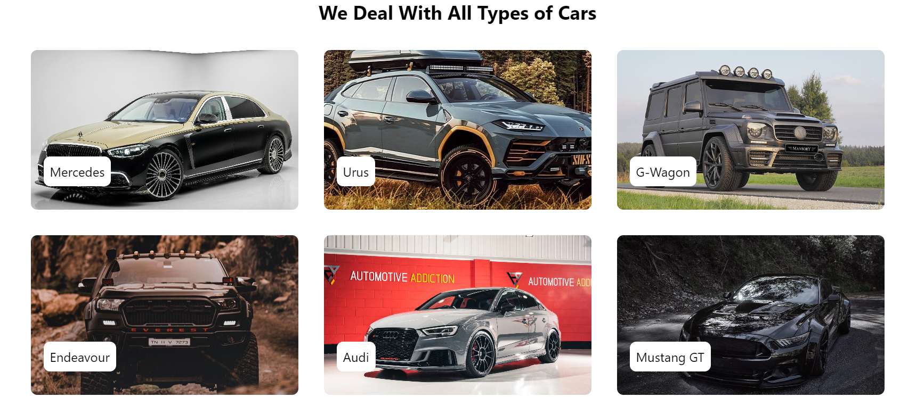
Detailing And Modification Overview

Slide 20
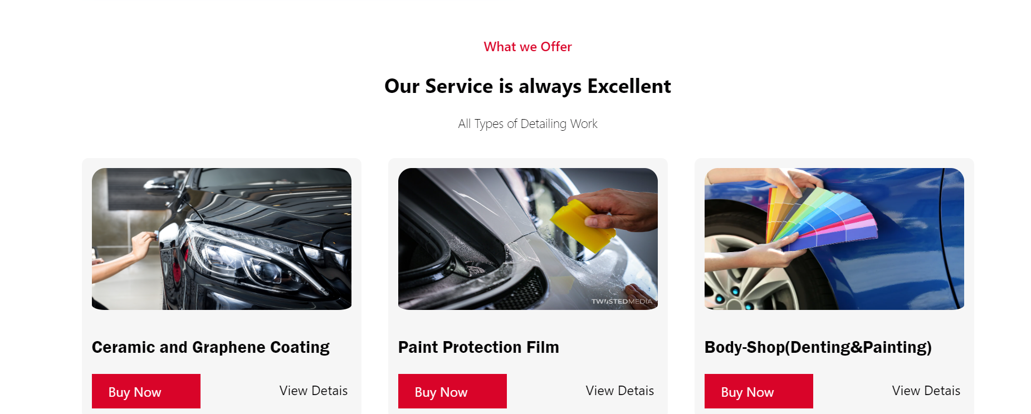
Detailing And Modification Overview

Slide 21
Conclusion
In conclusion, WheelDeal represents more than just a luxury car rental and customization platform.
It embodies a commitment to excellence, a dedication to customer satisfaction, and a passion for delivering unforgettable experiences on the road.
As you embark on your journey with WheelDeal, rest assured that you're not just renting a car – you're immersing yourself in a world of luxury, sophistication, and unparalleled service.
We invite you to explore our website, browse our exquisite collection of vehicles, and experience the thrill of driving like never before.
Thank you for considering WheelDeal for your luxury car rental and customization needs. We look forward to exceeding your expectations and creating memories that last a lifetime.
Welcome to the WheelDeal family – where every ride is a celebration of luxury and style.

Slide 22

THE END

